Slide 1
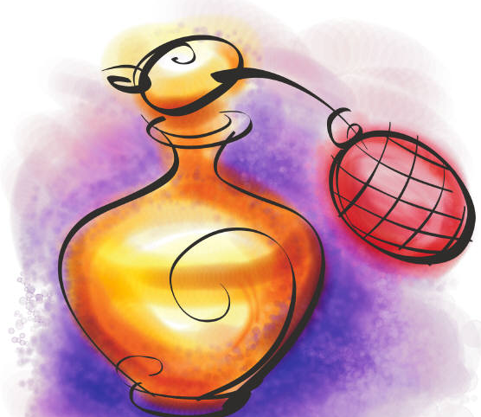
Dear you are invited to Perfume Party
for my 11th Birthday.
Place:
Date:
Time:
Please come, it will be so fun creating and naming our own perfumes!
RSVP:

