Slide 1
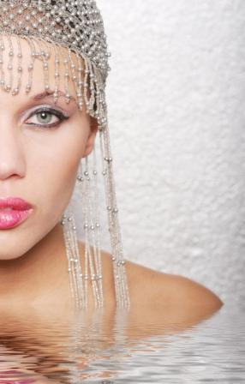

Dear
please come along to My Perfume Party for my 14th birthday
We actually get to design and create and name our own real perfumes, just like Brittany Spears, Gwen Stefani, Beyonce Knowles, Kylie Minogue, Christina Aguilera, and all those other celebs. And they all get made at the party, so everyone goes home with their own creation.
The place:
The date:
This will be so much fun !!
RSVP:

