Slide 1
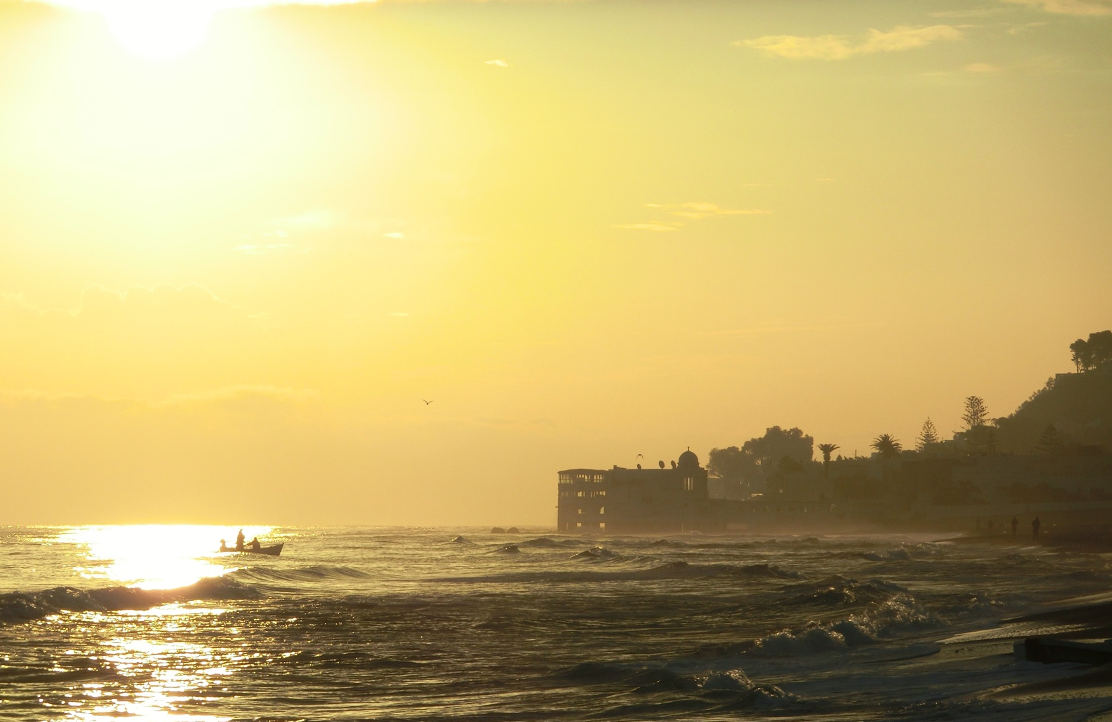
The smells of the flora and the forest dance and twist, stirred by the ocean breeze; intoxicating jasmines tango with earthy patchouli, calming lavender waltzes with comforting rose, warm woods and sweet orange blossom cavort with fire hot spices; rich memories, stolen kisses, the language of perfume.
My Perfume Party
From:
To:
Date:
Place:
RSVP:

