Slide 1
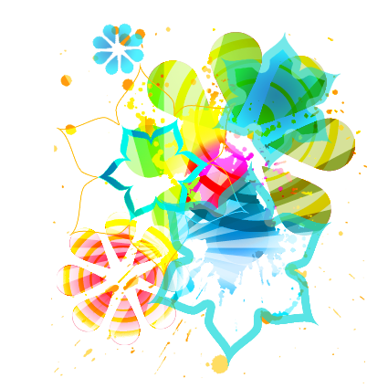
Oh what a commotion!
Making up our potions,
At my birthday perfume party.
Jessica loves the jasmine,
Whilst Jasmine loves the berries;
Megan’s gone mad on mountain airs
But Chloe’s just away with the fairies.
Laura loves the lemon scents,
Sasha’s spicy is so intense,
Brian reckons he’s a vanilla lover
Woh, stop! Who invited my brother?
Martha’s into earthy smells,
Misty, mossy, chanterelles.
Amber adores the ambergris,
Did you know it’s made from whale sneeze?
Laura’s got a dash of tonic sport,
Mine’s more a flowery sort,
Chloe’s decided on the woody now,
“Come smell this”, “Ummm, oh wow!”
Megan’s gone for something hearty,
Jessica’s gone all french and tarty,
But all agreed on one thing smartie,
This was a great idea for a party!
Dear,
Please come along to My Perfume Party to celebrate my birthday where we will be creating our very own unique perfumes. No brothers allowed!
The Place:
The Date:
RSVP:

