Slide 1
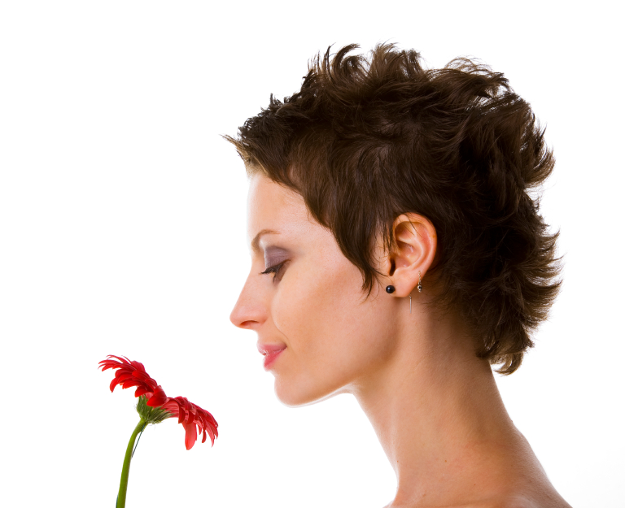
Dear
Please come along to My Perfume Party to celebrate my birthday where we will be creating our very own unique perfumes.
The Place:
The Date:
  Perfume is a silken web,
  intricate, beautiful,
  laced with promise,
  delicate yet strong,
  complex but simple,
  entwined with passion,
  enchanting.
RSVP:

