Slide 1
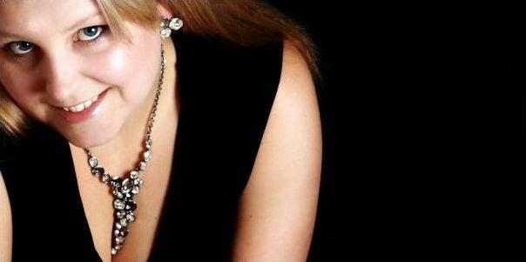
Pre-Prom Perfume Party
To compliment your beautiful dress, you need a perfume to make you feel like a million dollars.
Place :
Date :
RSVP :

