Slide 1
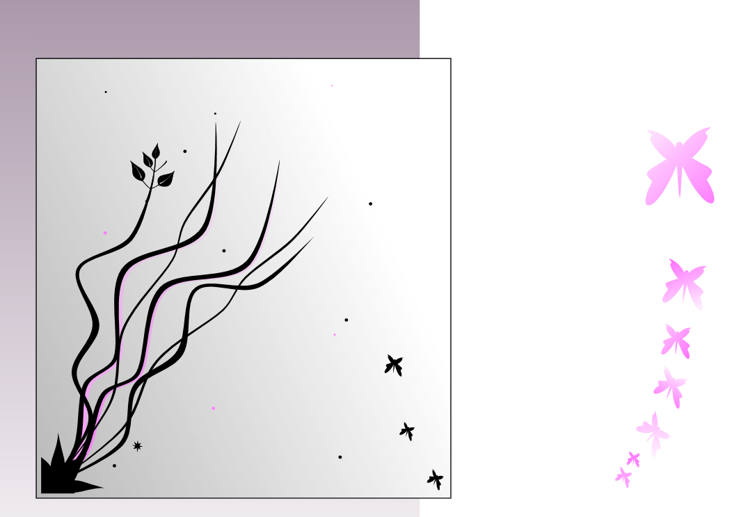
my perfume party
To
At
On
RSVP
I need to confirm bookings so please let me know as soon as you can. Thanks.
Come make perfume with me…
From a selection of beautiful perfume blends, choose your favourites to create your own unique and individual perfume, which is yours to name and take home.

